Slide 1
General Education Committee 2020-2021

Slide 2
Role of General Education Amid This Nexus of Uncertainty?
Notes:
Images:
https://www.washingtonpost.com/magazine/2019/11/25/visualizing-racism-photo-essay/?arc404=true
Image: https://www.flickr.com/photos/mikesagmeister/487582517
Image: https://www.politico.com/news/magazine/2020/03/19/coronavirus-effect-economy-life-society-analysis-covid-135579

Slide 3
To What Degree Did the Following Contribute: Percent Answering “Extremely” or “Significantly”
Openness to understand and communicate with others
General education courses: 26%
Courses other than general education: 40%
Connection to a faculty mentor or community mentor
General education courses: 16%
Courses other than general education: 41%
Heightened awareness of needs of others
General education courses: 22%
Courses other than general education: 30%
Knowledge of how multiple disciplines can work together
General education courses: 28%
Courses other than general education: 50%
Data Source: SERU 2017 Survey (ir.ufl.edu)

Slide 4
To What Degree Did the Following Contribute: Percent Answering “Extremely” or “Significantly”
Confirming your choice of major
General education courses: 21%
Courses other than general education: 63%
Connecting your major to what you believe is your life’s purpose
General education courses: 19%
Courses other than general education: 50%
Participate fully and responsibly as an informed global citizen
General education courses: 25%
Courses other than general education: 41%
Increase in valuable skills, including oral and written communication and critical thinking
General education courses: 35%
Courses other than general education: 57%
Data Source: SERU 2017 Survey (ir.ufl.edu)

Slide 5
Of the courses you have taken, could you identify which designations met the General Education requirement?
Level | N | M | I don’t know | I could identify a few | I could identify some | I could identify all
Freshman | 57 | 3.21 | 0% | 16% | 47% | 37%
Sophomore | 235 | 3.24 | 5% | 11% | 39% | 45%
Junior | 427 | 3.15 | 8% | 11% | 39% | 42%
Cont. Senior | 498 | 3.19 | 6% | 13% | 39% | 43%
Graduating Senior | 248 | 3.10 | 7% | 14% | 40% | 39%
Total | 1465 | 3.17 | 6% | 12% | 39% | 42%
Data Source: SERU 2017 Survey (ir.ufl.edu)

Slide 6
Responsibilities of This Committee
This committee establishes a philosophy of what constitutes the general education component for baccalaureate degrees offered by the University.
It reviews, in accordance with established criteria, all courses proposed to fulfill General Education and University Writing and Math requirements.
It makes recommendations to the Curriculum Committee regarding the continued effectiveness of the general education program.
http://fora.aa.ufl.edu/University/JointCommittees/General-Education-Committee

Slide 7
Active GE Courses: Fall 2019
General Education Designation | Active Courses
Biological Sciences | 81
Composition | 18
Humanities | 433
Mathematics | 36
Physical Sciences | 89
Social & Behavioral Sciences | 197
Total GE Courses | 854
Courses with Shared GE Designations
Diversity | 51 (6%)
International | 374 (44%)
Composition (Shared) | 16 (2%)
*There is no current data for Writing courses

Slide 8
Work of this Committee: Brief 2019-2020 Recap
% courses with designations:
H: 38%
B: 13%
P: 13%
S: 30%
C: 6%
WR2000: 23%
WR4000: 9%
WR6000: 6%
D: 30%
N: 34%
Total number of courses reviewed: 53
Total number of Quest courses reviewed: Q1 (17); Q2 (27)
% courses approved: 100

Slide 9
Work of This Committee: Subcommittee Focus
Temporary:
APPROVAL FORM
AUDIT
WRITING
Standing:
ASSESSMENT
REVIEW

Slide 10
Expanded Roles of GEC in 2020-2021
ABSORB THE WORK OF THE QUEST CURRICULUM COMMITTEE
Establish and maintain the descriptions and standards of the Q1, Q2 designations
Partner with faculty submitters in course request preparation
Partner with Dr. Andy Wolpert in the flow and timing of Quest 1 and 2 course proposals, selection of Quest courses
Dr. John Krigbaum, Dr. Alison Reynolds, and Dr. Brenda Jo Smith will lead us in this expanded role.
DIVERSITY AND INCLUSION
Participate in campus-wide conversation about increased exposure of courses related to race, racism, and anti-racism
Create new subcommittee on Diversity and Inclusion in General Education
Connect to planned General Education Task Force on Diversity and Inclusion
Engage in educational opportunities related to Diversity and Inclusion in the curriculum and serve as leaders among faculty

Slide 11
Expectations of Members
MINIMUM LEVEL
Be familiar with General Education requirements, learning outcomes, submission process, etc.
Participate in monthly meetings. Notify Casey Griffith if unable to participate in a meeting.
Review agenda in advance and be prepared to engage in helpful discussion concerning agenda items
Serve as partners for faculty submitters in the request preparation and review stages
REQUESTED LEVEL
Contribute to the focus of one sub-committee

Slide 12
Communication to Members
If you have not received emails or calendar invitations concerning the GEC, please let Casey Griffith know.
We will send more information about a GEC Teams page to share documents, messages, etc.

Slide 13
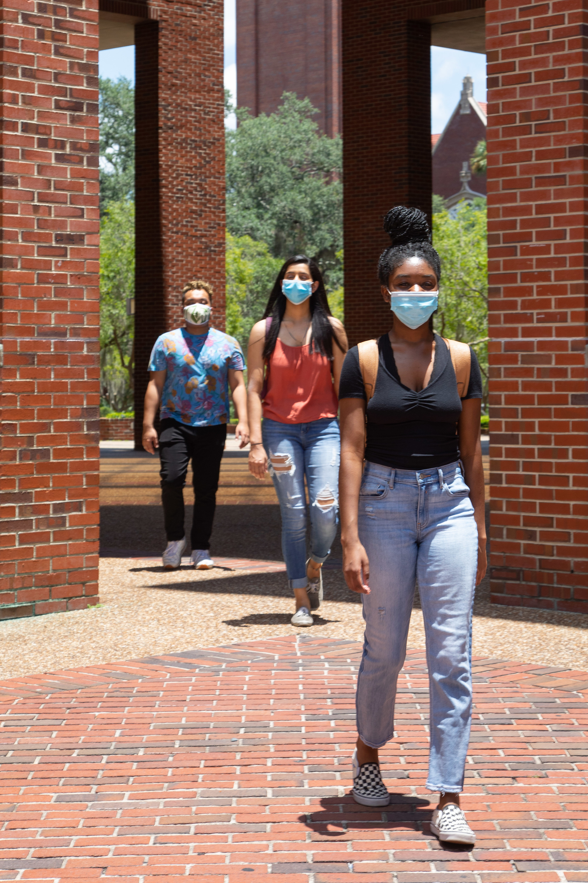

Slide 14
Co-Chair Voting
Faculty Senate Members Only!

